Slide 1






Arlo : Battle Teams
2nd
1st
2nd
3rd
2nd

Slide 2

Cliff : Battle Teams
2nd
1st
2nd
3rd
2nd

Slide 3

Sierra : Battle Teams
2nd
1st
2nd
3rd
2nd

Slide 4
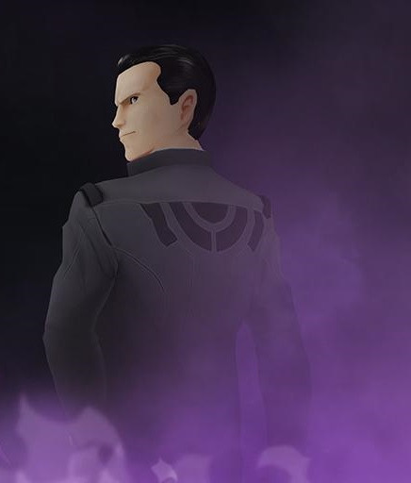

Giovanni : Battle Teams
2nd
1st
2nd
3rd
2nd

